Slide 1
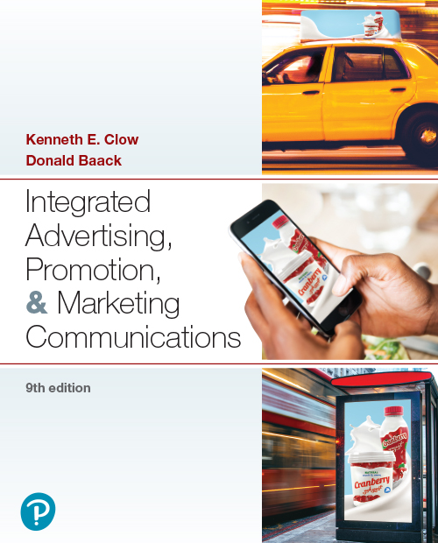

Integrated Advertising, Promotion, and Marketing Communications
Ninth Edition
Chapter 8
Digital and Mobile Marketing
Copyright © 2022, 2018, 2016 Pearson Education, Inc. All Rights Reserved
Notes:
If this PowerPoint presentation contains mathematical equations, you may need to check that your computer has the following installed:
1) MathType Plugin
2) Math Player (free versions available)
3) NVDA Reader (free versions available)

Slide 2
Chapter Objectives (1 of 2)
8.1 What is digital marketing?
8.2 How have newer consumer shopping patterns affected the field of marketing communications?
8.3 How can e-commerce programs and incentives build a stronger customer base and overcome consumer concerns at the same time?
8.4 How do companies utilize mobile marketing systems?
Notes:
These are the objectives for Chapter 8.

Slide 3
Chapter Objectives (2 of 2)
8.5 What digital strategies do marketing professionals employ?
8.6 What types of web advertising can companies use to reach consumers?
8.7 What is a search engine optimization strategy?
8.8 How can companies successfully conduct digital marketing programs in international markets?
Notes:
These are the additional objectives for Chapter 8.

Slide 4
Chapter Overview
Digital marketing
E-commerce
Mobile marketing
Digital strategies
Web advertising
Search engine optimization
International markets
Notes:
Chapter 8 opens with a discussion on new ways of communicating and engaging consumers. Digital marketing involves e-commerce, internet marketing, and mobile marketing. Next comes a discussion of e-commerce programs followed by mobile marketing methods. The chapter concludes with information about strategies, online advertising methodologies, search engine optimization, and international markets.

Slide 5

Artificial Intelligence, Programmatic Advertising, and Chatbots
Artificial intelligence aids consumer behavior analysis
Programmatic advertising enables advanced consumer targeting
Chatbots answer questions, offer product information
Notes:
Keeping current with digital and alternative marketing is a major challenge for firms wanting to transmit messages and create venues to facilitate interactions with customers. Three rapidly emerging trends include the use of artificial intelligence, programmatic advertising, and chatbots. These three technologies mesh with the most recent consumer purchasing patterns. They also lead to efficient instant and interactive communications with customers and prospects.

Slide 6
Digital Marketing
Today’s consumers rely on digital technologies
Digital marketing combines components of:
E-commerce
Internet marketing
Mobile marketing
Notes:
Think of all the ways in which today’s consumers and businesses rely on digital technologies. They use it to research products, make comparisons, read comments by other consumers, interact with other consumers and businesses, and make product purchases. As we can see here, digital marketing includes anything with a digital footprint.

Slide 7

Consumer Shopping Patterns
Shopping locations
Delivery methods
Consumer-to-consumer marketing (C-to-C)
Services
Notes:
Digital and mobile marketing programs have dramatically altered the ways in which consumers purchase products. These patterns have influenced the natures and emphases of many integrated marketing communications programs. As we can see here, three primary changes have occurred. First, a shift in where, how, and when consumers examine products, companies, and brands has taken place. Second, the methods by which consumers physically obtain goods continue to evolve. Third, consumer-to-consumer sales have increased.

Slide 8
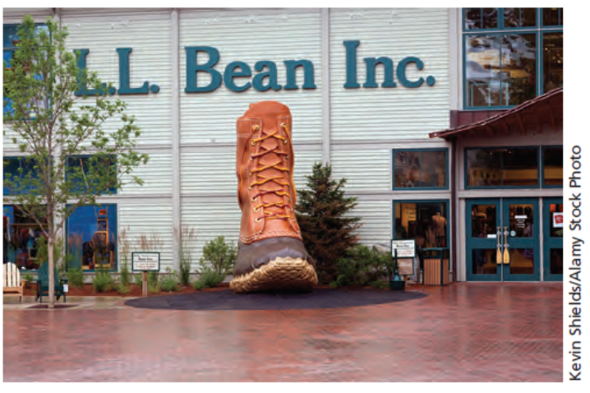
E-Commerce
Marketing goods and services over the internet
B-to-C and B-to-B online commerce
Online sales 10 percent of retail activity
Notes:
E-commerce markets goods and services over the internet. It is conducted in both the consumer sector and the B-to-B sector. Online sales now account for around 10% of total retail activity. This percentage continues to grow at a faster rate than brick-and-mortar retail sales. As shown here, traditional catalog/retail-based chains such as L.L. Bean now incorporate digital methods into their overall marketing and marketing communications programs.

Slide 9
Figure 8.1: Characteristics of Successful E-Commerce Sites
Search-optimized design
Customer-centric design
Mobile-optimized design
Consistent customer experience
Channel integration
Brand engagement
Shopping cart abandonment strategies
E-commerce incentives
Offline marketing integration
Notes:
This is a list of what it takes to create successful e-commerce sites. The focus is on e-commerce being customer-centric with opportunities for engagement and communication. The other main aspect is channel integration.

Slide 10
Successful E-Commerce Search-Optimized Design
Majority of Americans do online research
Location on search engine results page (S E R P)
Design important
Web search crawlers
Page title
Title tags
Notes:
Successful e-commerce sites are optimized for search engines. The design of the website impacts where a company or brand will appear on the SERP. In addition to content, web search crawlers look at page titles and title tags.

Slide 11
Successful E-Commerce Customer-Centric Design
Quickly locate merchandise
Indexed using customer terms
Drill-down search function
Unique product descriptions
Avoid thin and duplicate copy
Pictures better than words
4-6 products per page optimal
Notes:
Successful e-commerce sites are customer-centric. Customers should be able to easily locate merchandise. If the site has a large number of products, then a drill-down search function is needed. Search engines like unique product descriptions and penalize sites with thin and duplicate copy. Pictures are better than words. Optimal number of products is 4-6 per page.

Slide 12
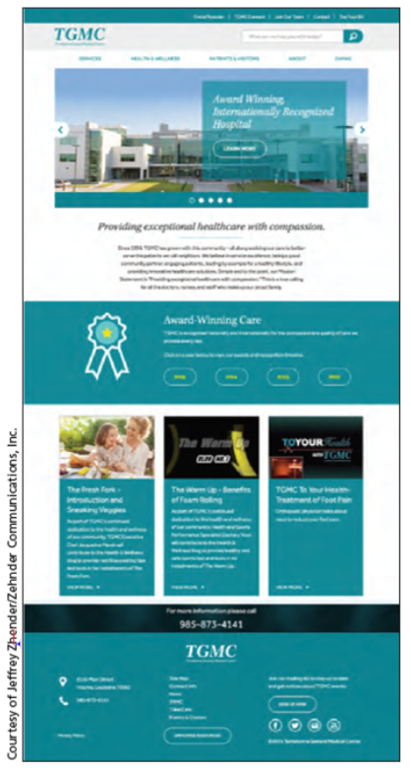
Successful E-Commerce Mobile-Optimized Design
Adaptive design
Higher interactions and conversions
Advantages
50% of online purchases made on mobile devices
Without adaptive design, ranked lower in search
Notes:
Successful e-commerce sites are mobile-optimized with adaptive design, which automatically adjusts to the scree size. Mobile-optimized designs have a higher conversion rate, 3.4% compared to 1.6%. About 50% of consumers making online purchases do so on their mobile device. Research found that websites without adaptive design ranked lower on searches. As shown here, Terrebonne General Medical Center offers a mobile-optimized website design.

Slide 13
Successful E-Commerce Consistent Customer Experience
Customers expect consistent, positive experiences
Zero tolerance for poor web performance
Dissatisfaction = lost sales
Load time a key factor
Notes:
E-commerce sites must be customer-centric and offer a consistently positive customer experience. With online shopping, consumers have nearly a zero tolerance for poor performance. Dissatisfaction results in lost sales. Especially important is the load time of pages and information.

Slide 14
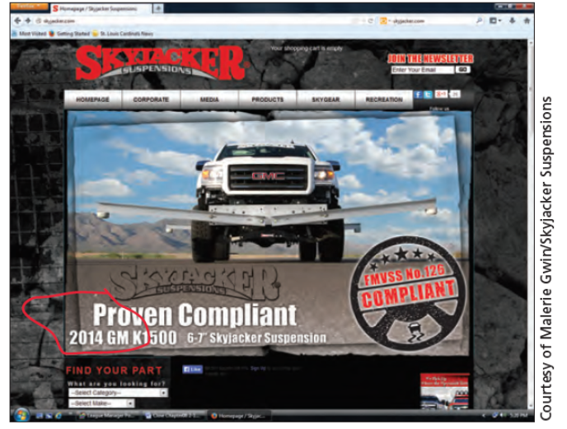
Successful E-Commerce Channel Integration
Essential for selling beyond the web
Online and offline catalogs integrated
Access from any digital platform
Notes:
Channel integration is essential. If a company has offline catalogs, they must match its online catalogs. Ordering has to be available through multiple platforms, such as mobile phones and tablets as well as through desktop computers. Channel integration is an important feature of Skyjacker’s website, shown here.

Slide 15
Successful E-Commerce Brand Engagement
Opportunities for engagement
Blogs, reviews, feedback
Personalization and customization
Notes:
Successful e-commerce provides opportunities for brand engagement. Blogs, reviews, and feedback mechanisms allow consumers to become involved with a brand. They provide a way for customers to express their thoughts and can serve as positive word-of-mouth endorsements. Visitors to a site appreciate personalization and customization of pages and information. Facebook, Twitter, and other sites enable customers to like a brand and become fans.

Slide 16
Successful E-Commerce Shopping Cart Abandonment
Show any additional costs
Make checkout simple
Make it easy to enter discount codes
Provide safe checkout procedures
Notes:
A high percentage of shoppers place items in a shopping basket, but never complete the transaction. This is a list of strategies firms can use to reduce the rate of shopping cart abandonment.

Slide 17
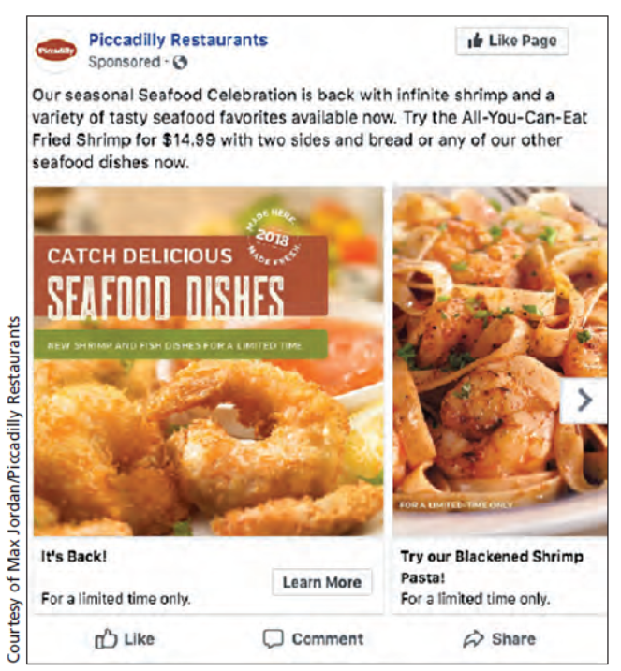
Successful E-Commerce E-Commerce Incentives
Cyberbait = lure or attraction to website
Incentives may be
Financial
Convenience
Value-added
Notes:
Any lure or attraction that brings people to a website is cyberbait. Common forms include financial incentives, convenience incentives, and value-added incentives. This Piccadilly Restaurant post focuses on a financial enticement—all you can eat fried shrimp at a great price.

Slide 18
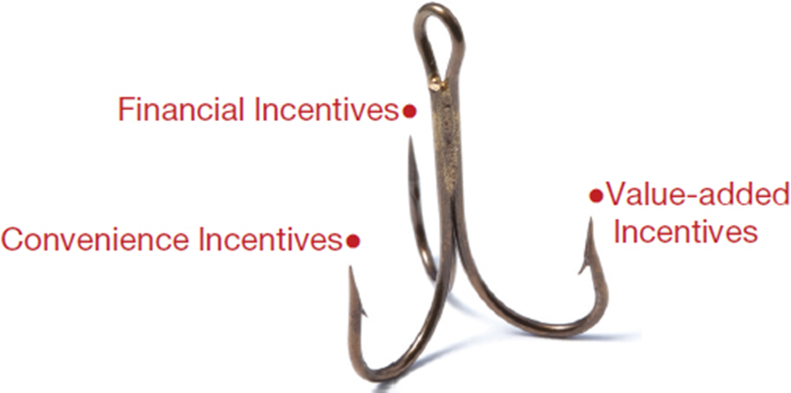
Figure 8.2: Common Forms of Cyberbait
Notes:
The various forms of incentives to encourage people to visit a website are finance-, convenience-, and value-added. These incentives are especially important for click-only businesses. Financial incentives can persuade an individual or business to make that first purchase. The most effective financial incentives are reduced prices, free shipping, and e-coupons. Convenience incentives make the online shopping experience easier and encourage return visits. Value-added incentives encourage customers to come back to an e-commerce site and change purchasing habits long-term.
The figure shows a 3 prong fish hook, each prong labeled as follows: financial incentives, value added incentives, convenience incentives.

Slide 19
Figure 8.3: Value-Added Incentives
Customized shopping
Unique product information
Mobile apps
Social media engagement
Exclusive shopping
Tutorials, usage tips, and repair instructions
Notes:
Value-added incentives lead consumers to change purchasing habits over the long term. This slide lists some of the value-added incentives that can be used. The goal is to provide a unique experience or unique opportunities that cannot be obtained in a retail store or at other websites.

Slide 20
Successful E-Commerce Offline Marketing Integration
Integrate offline marketing with e-commerce site
Information must match on all platforms
Include web U R L in all materials
Notes:
Without any type of offline advertising or marketing, attracting and keeping customers becomes difficult. Offline marketing efforts should be integrated with the e-commerce site.

Slide 21
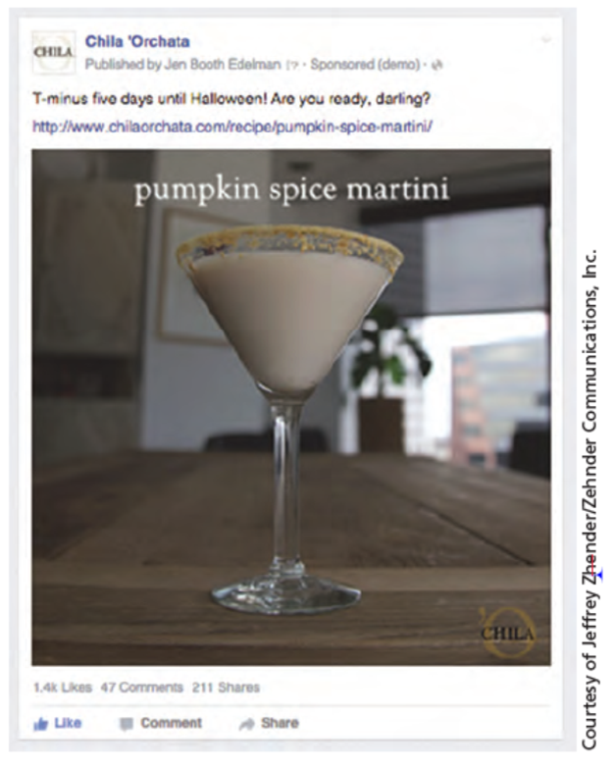
Mobile Marketing (1 of 2)
Smartphones, tablets, related devices
Websites, email, text messages, social media, mobile apps
Most consumers access internet via smartphones
Notes:
Over the past few years, consumer shopping patterns have dramatically changed. Mobile marketing is multi-channel online marketing designed to
reach consumers on smartphones, tablets, or other related devices through websites, email, text messages, social media, or mobile apps. Mobile marketing reaches every type of device. Most consumers access the internet from a smartphone rather than a desktop or laptop computer, especially younger individuals. Mobile devices enable brands such as Chila Orchata (shown here) to interact with consumers through social media.

Slide 22
Figure 8.4: Ways Mobile Differs from Other Media
Personal
Geo-location
Two-way communication
Camera/video technology
Voice recognition
Phone sensors
Notes:
Mobile marketing differs from other media that provides marketers with opportunities, but also challenges. Mobile devices are personal, and typically used by only one individual. This provides an opportunity to engage with the individual. Embedded GPS technology allows for geo-locating of marketing messages based on a person’s location. Individuals use mobile phones to share photos and videos, and communicate with others. Brands can take advantage of these features. Phones now have voice recognition and number of sensors that can monitor the temperature, human gesturing, and other activities.

Slide 23
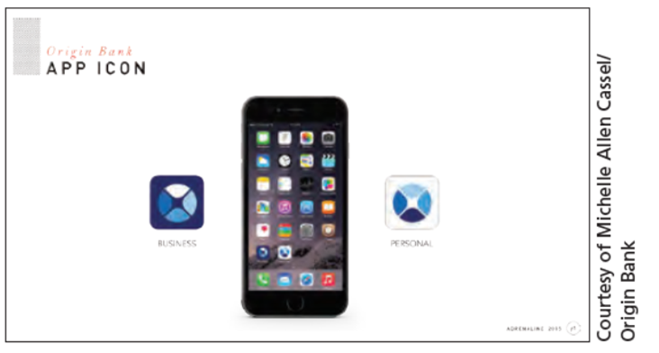
Mobile Marketing (2 of 2)
Mobile Apps
Engage consumers with brand
Streamline business use
Action codes
Q R codes, watermarks, and 2D barcodes
Goal is engagement
Notes:
Mobile apps either engage consumers with the brand or streamline the business transaction that occurs. Globally, consumers download more than 32 billion apps per year. Another form of mobile marketing is using action codes, such as QR codes, watermarks, and 2D bar codes. These action codes are designed to engage the consumer with the brand in some manner, such as accessing a website or watching a video. Here, we see an example of an app developed by Origin Bank for its customers.

Slide 24
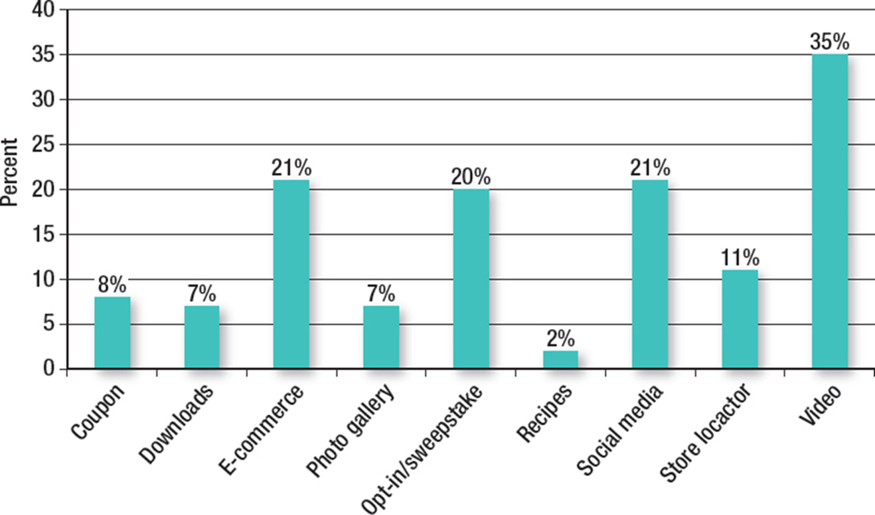
Figure 8.5: Marketers’ Uses for Action Codes
Notes:
This graph provides data on how marketers are using action codes. The number one-usage is to access videos. Other important uses include e-commerce, opt-in sweepstakes, and social media.
The y axis is labeled percent and ranges from 0 to 40. The x axis has vertical bars with labels and data from left to right as follows:
Coupon 8 percent
Downloads 7 percent
E commerce 21 percent
Photo gallery 7 percent
Opt in or sweepstake 20 percent
Recipes 4 percent
Social media 21 percent
Store locator 11 percent
Video 35 percent

Slide 25
Questions to Consider (1 of 2)
As a consumer, which types of mobile apps or action codes have you seen recently on your smartphone?
Did you find them to be useful? If so, how?
Did any of these apps or action codes encourage you to buy something? If so, how did it help?
Do you have any suggestions for improvements?
Notes:
Here, the idea is to get students talking about how they use mobile apps and action codes on their own smartphones. Try to get them to discuss which ones were most useful, how so, and what they purchased as a result.

Slide 26
Figure 8.6: Digital Marketing Strategies
Interactive marketing
Content and native marketing
Location-based advertising
Remarketing
Behavioral targeting
Blogs and newsletters
Email marketing
Notes:
As society has shifted from desktop computers to laptops, tablets, and smartphones, marketers have adapted to multi-screen formats. This has created challenges as well as opportunities for the various digital marketing strategies shown on this slide.

Slide 27
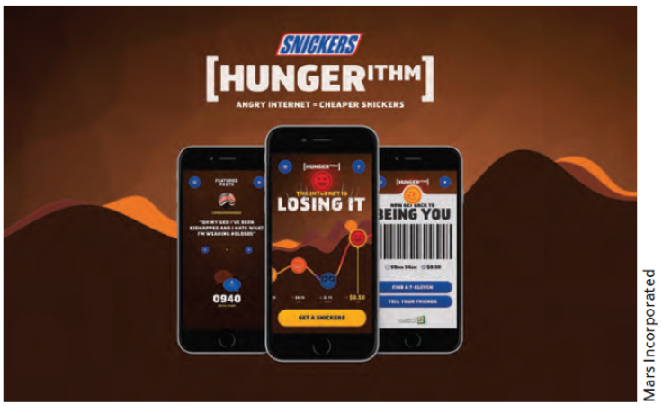
Interactive Marketing
Two-way communication and involvement
Targets individuals
Engages consumers
Tracks browser activities
Personalizes messages
Real time marketing
Notes:
Interactive marketing is the development of marketing programs that create two-way communications and enhance engagement of consumers with the brand. The internet can track browser activity, where a person goes, and what they do. It can personalize messages. The emphasis of interactive marketing is two-fold – to target individuals and to engage consumers. Real time marketing programs help consumers at just the right moment. As shown here, Snickers made effective use of a real time campaign labeled Hungerithm, sent via digital and mobile devices.

Slide 28
Figure 8.7: Content Marketing and Native Advertising
Blank | Content Marketing Branded Content | Content Marketing Sponsored Content | Native Advertising
Location | Brand’s website or microsite | Third-party site | Third-party site
Goals | Provide information Increase brand awareness Improve search results | Provide information Increase brand awareness Increase social engagement | Generate sales Increase brand awareness Increase social engagement
Tone | Educational Solve a problem | Educational Authentic, expert tone | Solve problem through brand purchase
Audience | Brand’s customers and prospects | Sponsor’s audience | Third-party’s audience
Notes:
Content marketing is not self-promotion or trickery to generate sales. It focuses on providing information and solutions that are important to consumers, that is authentic. Content marketing should provide shareable content. It should be integrated with the website content. It needs to enhance search results and integrate with the social pages of the brand. It is vital that content is updated regularly. Rather than create branded content, a brand may sponsor a blog or related websites. The same keys to success are important. Information needs to be sharable and relevant to consumers. There is a potential for negative reaction if consumers see the sponsored content as self-promotion or just a venue for pushing sales. Native advertising is always on a third-party website and the goals are to generate sales, increase brand awareness or engagement. While it looks like an article, the tone is to solve a problem through purchasing the brand.

Slide 29
Figure 8.8: Location-Based Advertising
Targeting by D M As (designated marketing areas), 30%
Geo-fencing, 27%
Audience-data targeting, 24%
Geo-aware advertising, 14%
City or zip code, 5%
Notes:
Location-based advertising, often called geo-targeting, utilizes the GPS on mobile devices to send targeted messages to individuals based on their geographic location. Restaurants and retailers are investing dollars into this form of mobile marketing. This slide shows the various ways location-based advertising is done. Targeting by DMAs is a broad approach reaching a high number of consumers with a specified DMA. Geo-fencing targets individuals within a short distance of a retail location. Audience-data targeting adds information about consumers to the geographical location information. Geo-aware advertising uses real-time location information to target individuals close to the retail outlet.

Slide 30

Remarketing
Engages past visitor to revisit
Shown interest in brand/product
Higher conversions
Ad to computer or mobile device
Abandoned shopping cart
Notes:
Remarketing involves sending an ad to a person’s computer or mobile device based on his/her visit to the website. The visit shows the individual has some level of interest, which results in a higher conversion rate. Individuals who abandon shopping carts are excellent to target this way.

Slide 31
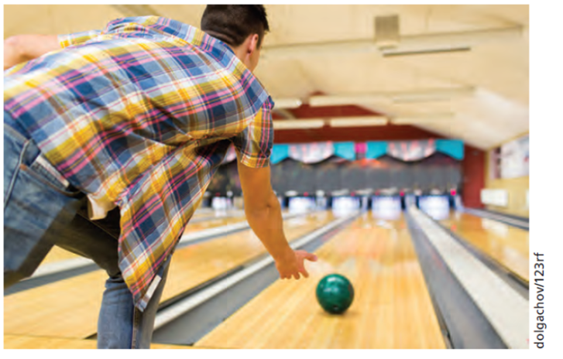
Behavioral Targeting
Uses web data
Pages visited on the internet
Keyword searches or content read
Past visitors to a site
Notes:
Behavioral targeting uses web data to identify and create targeted advertising messages. Behavioral targeting can be based on pages a person has visited on the internet. It can be based on keyword searches an individual has typed into a search engine or content that has been read. Behavioral targeting can be based on the browsing behavior of other visitors. Amazon does this when the company says “others who purchased this book also purchased ….” As shown here, behavioral targeting can be used to target bowlers with digital advertisements to individuals who have visited bowling-related websites.

Slide 32

Blogs, Podcasts, and Newsletters
Blogs are online musings
Power of online buzz
Company-sponsored blogs
Objective of blog
Reaction strategy for negative comments
Small businesses
Newsletters
Offer solutions and information
Update regularly
Notes:
Blogs and podcasts cover a wide range of topics. Blogs are online musings, written content put on the web for others to read. Some blogs permit visitor comments, others do not. Blogs provide a venue for people to talk online and can generate considerable online buzz, especially for hot topics. Having a company-sponsored blog reassures shoppers and gives them a glimpse of how the company deals with customers. It is an avenue for the company to release new information and for customers to voice opinions. Most importantly, the company controls the website and has an opportunity to respond to complaints. It is important to be honest and not suppress negative comments.

Slide 33

Email Marketing
Vital part of digital strategy
Integrate with other channels
Resemble information on website
Uses web analytics
Browsing history
Individuals who abandon shopping cart
Targeted emails = higher conversion rates
Notes:
Email is an important component of digital marketing. It can be easily integrated with other channels of communication. It can resemble information that is posted on the website. Email campaigns offer the advantage of having web analytics for an analysis of effectiveness. Web analytics can be used to measure how many people visit a website, where they go on the site, how long they stay at each place on the site, and who abandons the shopping cart before making a purchase. By using web analytics, companies can target specific individuals, such as those who abandon their shopping carts. These targeted emails have a much higher conversion rate.

Slide 34
Figure 8.9: Developing Successful Email Campaigns
Be upfront, honest with subscribers
Build list for quality, not quantity
Give subscribers what they want
Be familiar to your audience
Keep emails neat and clean
Be eye-catching
Integrate social media
Test, test, and test
Notes:
Following these key points will help you to develop a successful email marketing campaign. It is important to be upfront and honest with subscribers. Build a list for quality, not quantity. Give subscribers what they want, something of value, and show you understand and are familiar with the audience. Keep emails neat and clean, but make them eye-catching. Integrate the email campaign with the social media components. Lastly, be sure to test everything to learn the most successful tactics.

Slide 35
Questions to Consider (2 of 2)
As a consumer, how do you respond to e-mail campaigns?
What determines whether you read the marketing messages or simply delete them?
Do you ever use emails as a way to access the company’s social media? Examples?
Notes:
As students are likely to be younger consumers, you can generate an interesting discussion about this “old-school” online marketing method. It is important to point out the sturdy reliability of this channel and how it can be integrated with other media forms.

Slide 36
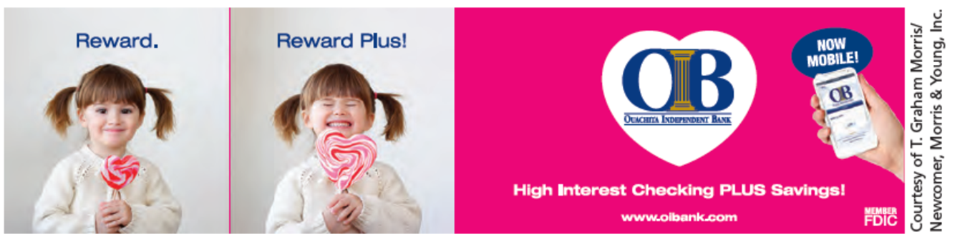
Web Advertising Programmatic Advertising
Banner ads account for 22.6% of online advertising
Can use videos, widget apps, targeted display ads
Enables precise targeting of consumers
Notes:
Web advertising is effective if ads are placed on the right websites, and the messages resonate with individuals. It is an excellent method of reaching consumers who tend to be younger, more affluent, and internet savvy. Budgets for online advertising have increased in recent years and will continue to increase. One reason for the shift to online advertising is the metrics available to measure results. Online metrics provide almost instant measurements of results.

Slide 37
Widgets
Mini-applications embedded in banners
Access external dynamic content
Provide personalized access to information
Micro-site landing pages
Geo-targeted ads
Notes:
Widgets are mini-applications embedded in banners. The widget can access external content. It can provide personalized access to information that resides outside of the banner ad and even outside of the website. When clicked, widgets will often take individuals to micro-site landing pages designed for that widget and that brand. These landing pages can even be geo-targeted where different individuals will be taken to different micro-sites based on their geographic location.

Slide 38
Impact of Online Advertising
Banner click-through rate 0.27%
Improve response through targeting
Third-party tags
Ads not seen
Below the fold
Blocking software
Fraud
Notes:
More advertising dollars have shifted to online, but consumers have become more immune, resulting in a response click-through rate for banner ads of 0.27%. To improve response rates, advertisers are targeting individuals using web metrics. Third-party tags have increased dramatically, 267%. Three primary reasons for poor response rates and ads not being seen – 1) ads are below the fold and browsers have to scroll down to see them, 2) consumers are using software to block ads, and 3) fraud. Malicious software and bots can be used to create impressions that ads are being seen when they are not.

Slide 39
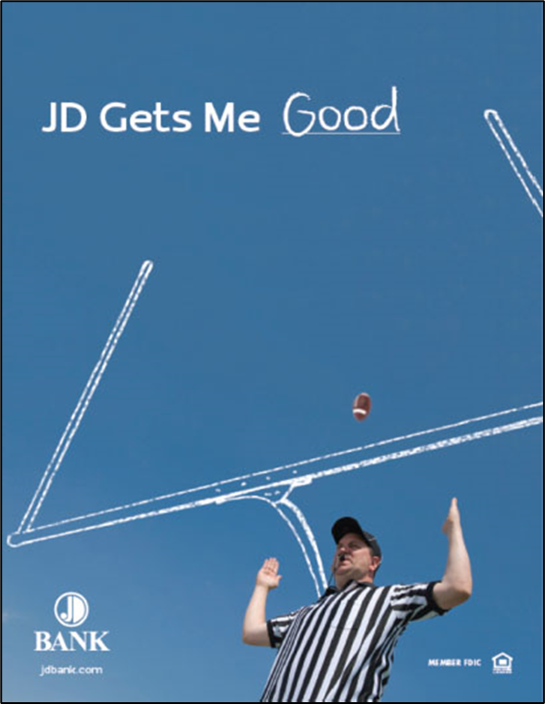
Offline Advertising
Integration of offline with online
Brand spiraling
Personalized U R Ls
Notes:
Brand reputations and brand loyalty require integrating offline and online advertising. Brand spiraling involves using traditional media to promote and attract consumers to a website. Traditional media can be effective in driving web traffic A current trend is to use PURLs, personalized URLs, which allow for a personalized page on a website. Online advertising is an important part of building an online presence for brands such as JD Bank, shown here.

Slide 40
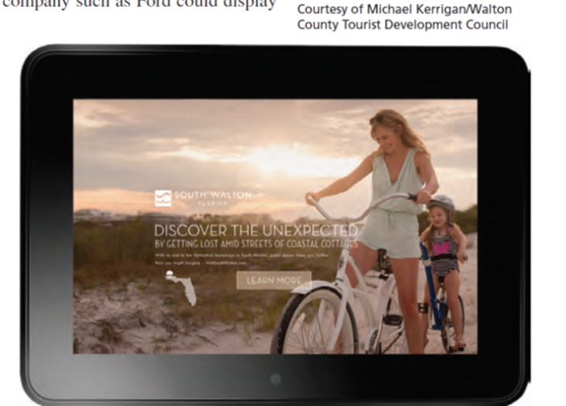
Search Engine Optimization
Nearly 50% of online ad expenditures
Majority of web traffic begins with a search
Three methods of S E O
Paid search insertion
Natural or organic emergence
Paid search ads
Effective for local businesses
Notes:
The largest category of online expenditures is now for search engine optimization (SEO). Nearly 50% of online advertising dollars are spent on SEO. The majority of web traffic begins with an online search, so having a presence in that search process is important. SEO can be reached in three different ways. First, with paid insertions, advertisers pay to have their website appear as the result of a search. Second comes natural or organic emergence. This is the best method because it is natural and the result of the search engine’s algorithms. It takes time to be near the top of natural or organic search results, but the method yields the best results. The third method involves using paid search ads that will appear on the page. Search engine optimization is effective for local businesses. As shown here, search engine optimization is a significant component of Visit South Walton’s marketing outreach.

Slide 41
International Implications
Worldwide reach a major e-commerce advantage
Potential issues
Shipping
Communication
Technology
Utilize coherent I M C strategy with local input
Notes:
A major advantage of digital marketing is that it can be global. It doesn’t matter where the customer is or where the company is located. However, a number of e-commerce businesses do not take advantage of global customers. Shipping can be an issue. It may be difficult and expensive to ship a product to Japan or India. Communication can be an issue, although many people can read English. Technology is important to consider. Videos that play well with broadband connections may not work well in other countries with slower speeds.

Slide 42
Your Career: Digital Marketing
Purchase your online name
Conduct internet search of your name
Develop online presence
Learn more about digital advertising
Notes:
The first step in using digital marketing in a career is to purchase your online name. You don’t have to build a website yet but should at least own your name URL. The second step is to conduct an internet search of your name. Closely examine where your name appears. This may be surprising. A third digital strategy is to develop an online presence. In addition to your website, you may want to consider writing a blog. If you are interested in marketing as a career, learn more about digital advertising. Visit a local advertising agency to see about an internship, or if someone would be willing
to share with you information about digital advertising. Having knowledge of how it all works provides an advantage over other applicants.

Slide 43
Blog Exercises
Consumer to Consumer (C2C) Marketing
App Design
Search Engine Optimization
Notes:
The blog exercises for Chapter 8 include Consumer to Consumer (C2C) Marketing, App Design, and Search Engine Optimization.

Slide 44

Copyright
This work is protected by United States copyright laws and is provided solely for the use of instructors in teaching their courses and assessing student learning. Dissemination or sale of any part of this work (including on the World Wide Web) will destroy the integrity of the work and is not permitted. The work and materials from it should never be made available to students except by instructors using the accompanying text in their classes. All recipients of this work are expected to abide by these restrictions and to honor the intended pedagogical purposes and the needs of other instructors who rely on these materials.

